Slide 1

Linux Basics ( course IX )
I am
root!
Florentiu Ilie

Slide 2
Course Content
Course1: Startup and Shutdown +
Course2: Linux directory tree, SSH
Course3: File permissions, Environment variables +
Course4: Users, Groups, Jobs +
Course5: Processes, Logging, Archiving
Course6: Disk Partitioning, Filesystems
Course7: LVM
Course8: Backup, Useful commands
Course9: Networking
Course10: Basic Troubleshooting

Slide 3
Schedule
Initialization Test (20m)
Course 1-2(1h each)
Test 2 (20m)
Course 3-5
Test 3 (50m)
Course 6-7
Test 4 (30m)
Project ( 7days)
Project presentation (1h each student)
Course 8-10
Test 5 (20m)
Review of all courses 1-10 (1-2h)
Final Test 1 – theoretical (1h)
Final Test 2 – practical (1-2h)

Slide 4
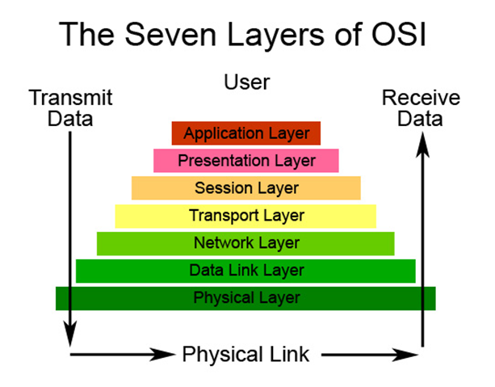
Networking
Basic Networking
OSI vs TCP/IP
OSI LAYER | DESCRIPTION
7. Application | Requests initiation of some service on a remote system
6. Presentation | Manages presentation of data to be independent of node hardware architecture
5. Session | Establishes, Synchronizes, Terminates communication sessions between source and destination
4. Transport | Manages end-to-end data transfer reliability
3. Network | Manages data addressing and delivery functions
2. Data Link | Performs packet framing and provides error detection functionality
1. Physical | Describes network hardware characteristics including electrical, mechanical, optical and functional specifications

Slide 5
Networking
Networking at OS level
files:
/etc/sysconfig/network-scripts/
files for NICs:
ifcfg-…
files for static routes:
routes ( SUSE )
route-… ( REDHAT )
/etc/sysconfig/network – set hostname and/or default route
/etc/hostname – set hostname
/etc/hosts – set hostnames
/etc/resolv.conf – set dns domains
/etc/nsswitch.conf – configuration will select files or dns for name resolution
Commands:
ifconfig
route
netstat
ethtool
nmtui ( REDHAT )
yast2 ( SUSE )
ping
traceroute

Slide 6

Questions ?

